Slide 1
Chapter4 Logic Gates

Slide 2
Objective
use the following logic gate symbols:
NOT AND OR NAND NOR XOR
understand and define the functions of NOT, AND, OR, NAND, NOR and XOR (EOR) gates, including the binary output produced from all the possible binary inputs (all gates, except the NOT gate, will have two inputs only)
construct the truth table for each of the logic gates above
construct a logic circuit from either:
– a problem statement
– a logic expression
construct a truth table from either:
– a logic circuit
– a logic expression
show understanding that some circuits can be constructed with fewer gates to produce the same outputs

Slide 3
Boolean Constants and Variables
Boolean 0 and 1 do not represent actual numbers but instead represent the state, or logic level.
Logic 0
Logic 1
False
True
Off
On
Low
High
No
Yes
Open switch
Closed switch

Slide 4
Three Basic Logic Operations
OR
AND
NOT

Slide 5
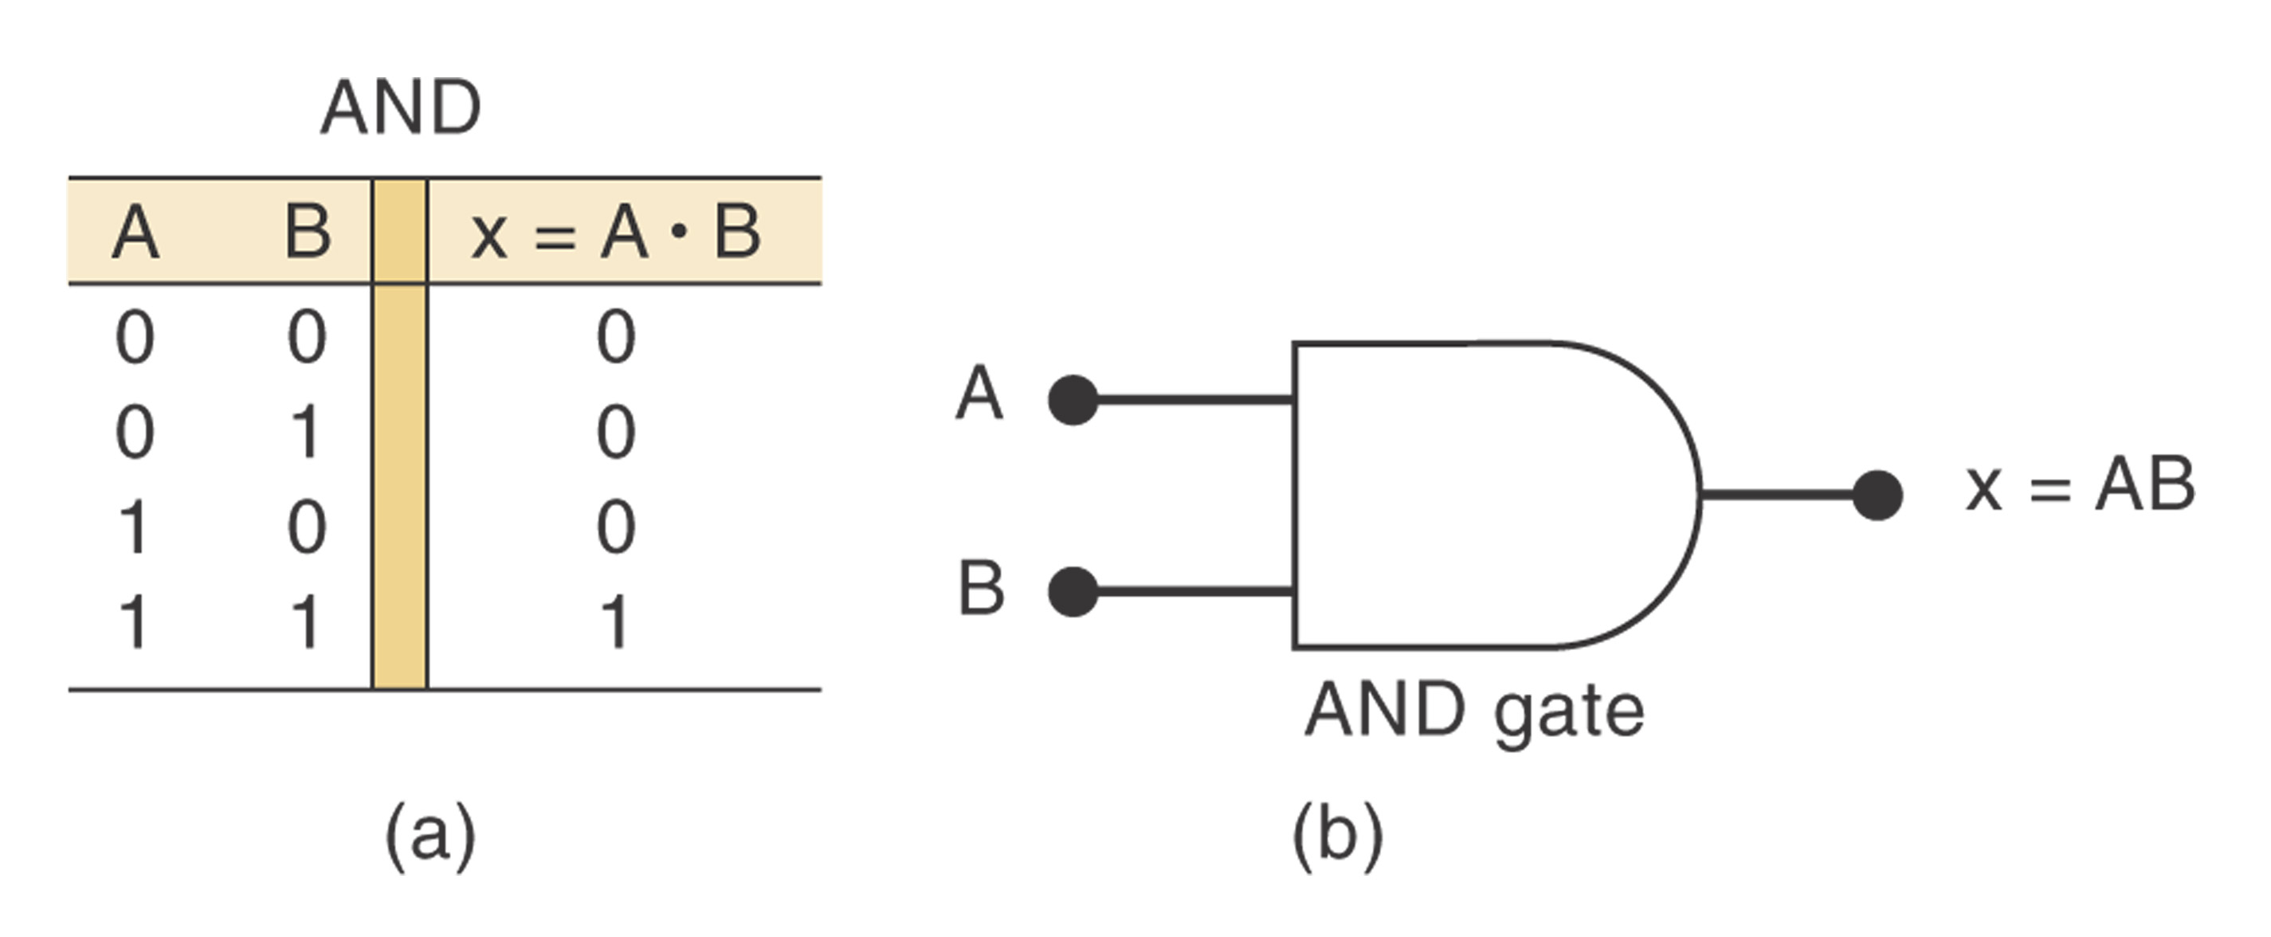
AND Operation
Boolean expression for the AND operation: x =A·B
The above expression is read as “x equals A AND B”

Slide 6
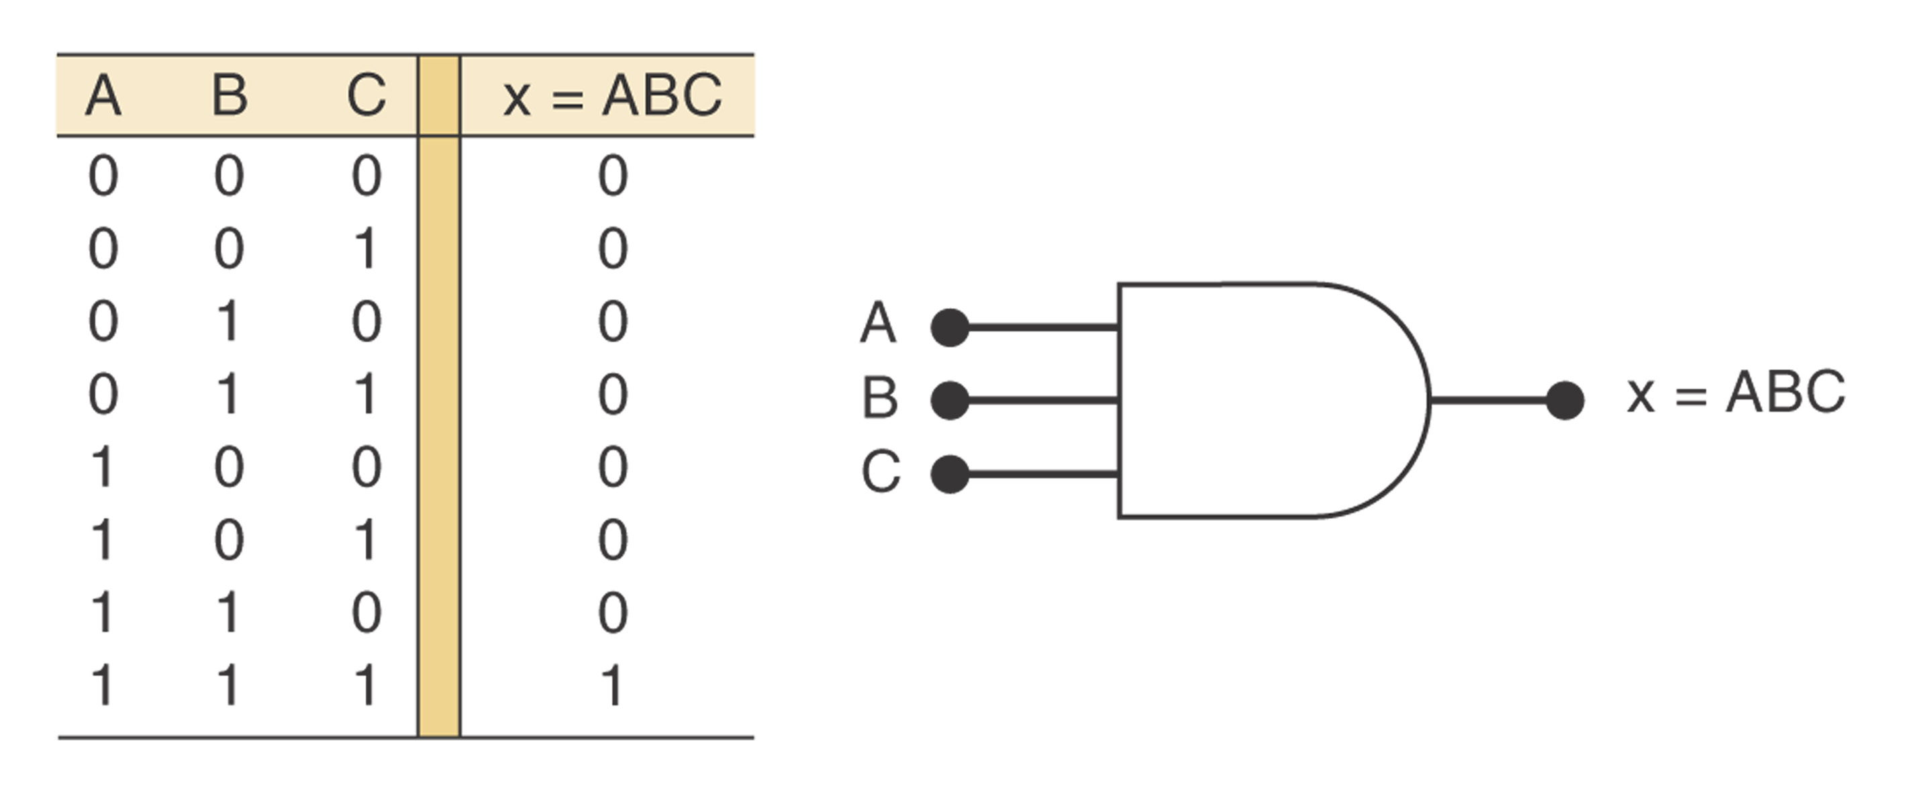
AND Gate
An AND gate is a gate that has two or more inputs and whose output is equal to the AND product of the inputs.

Slide 7
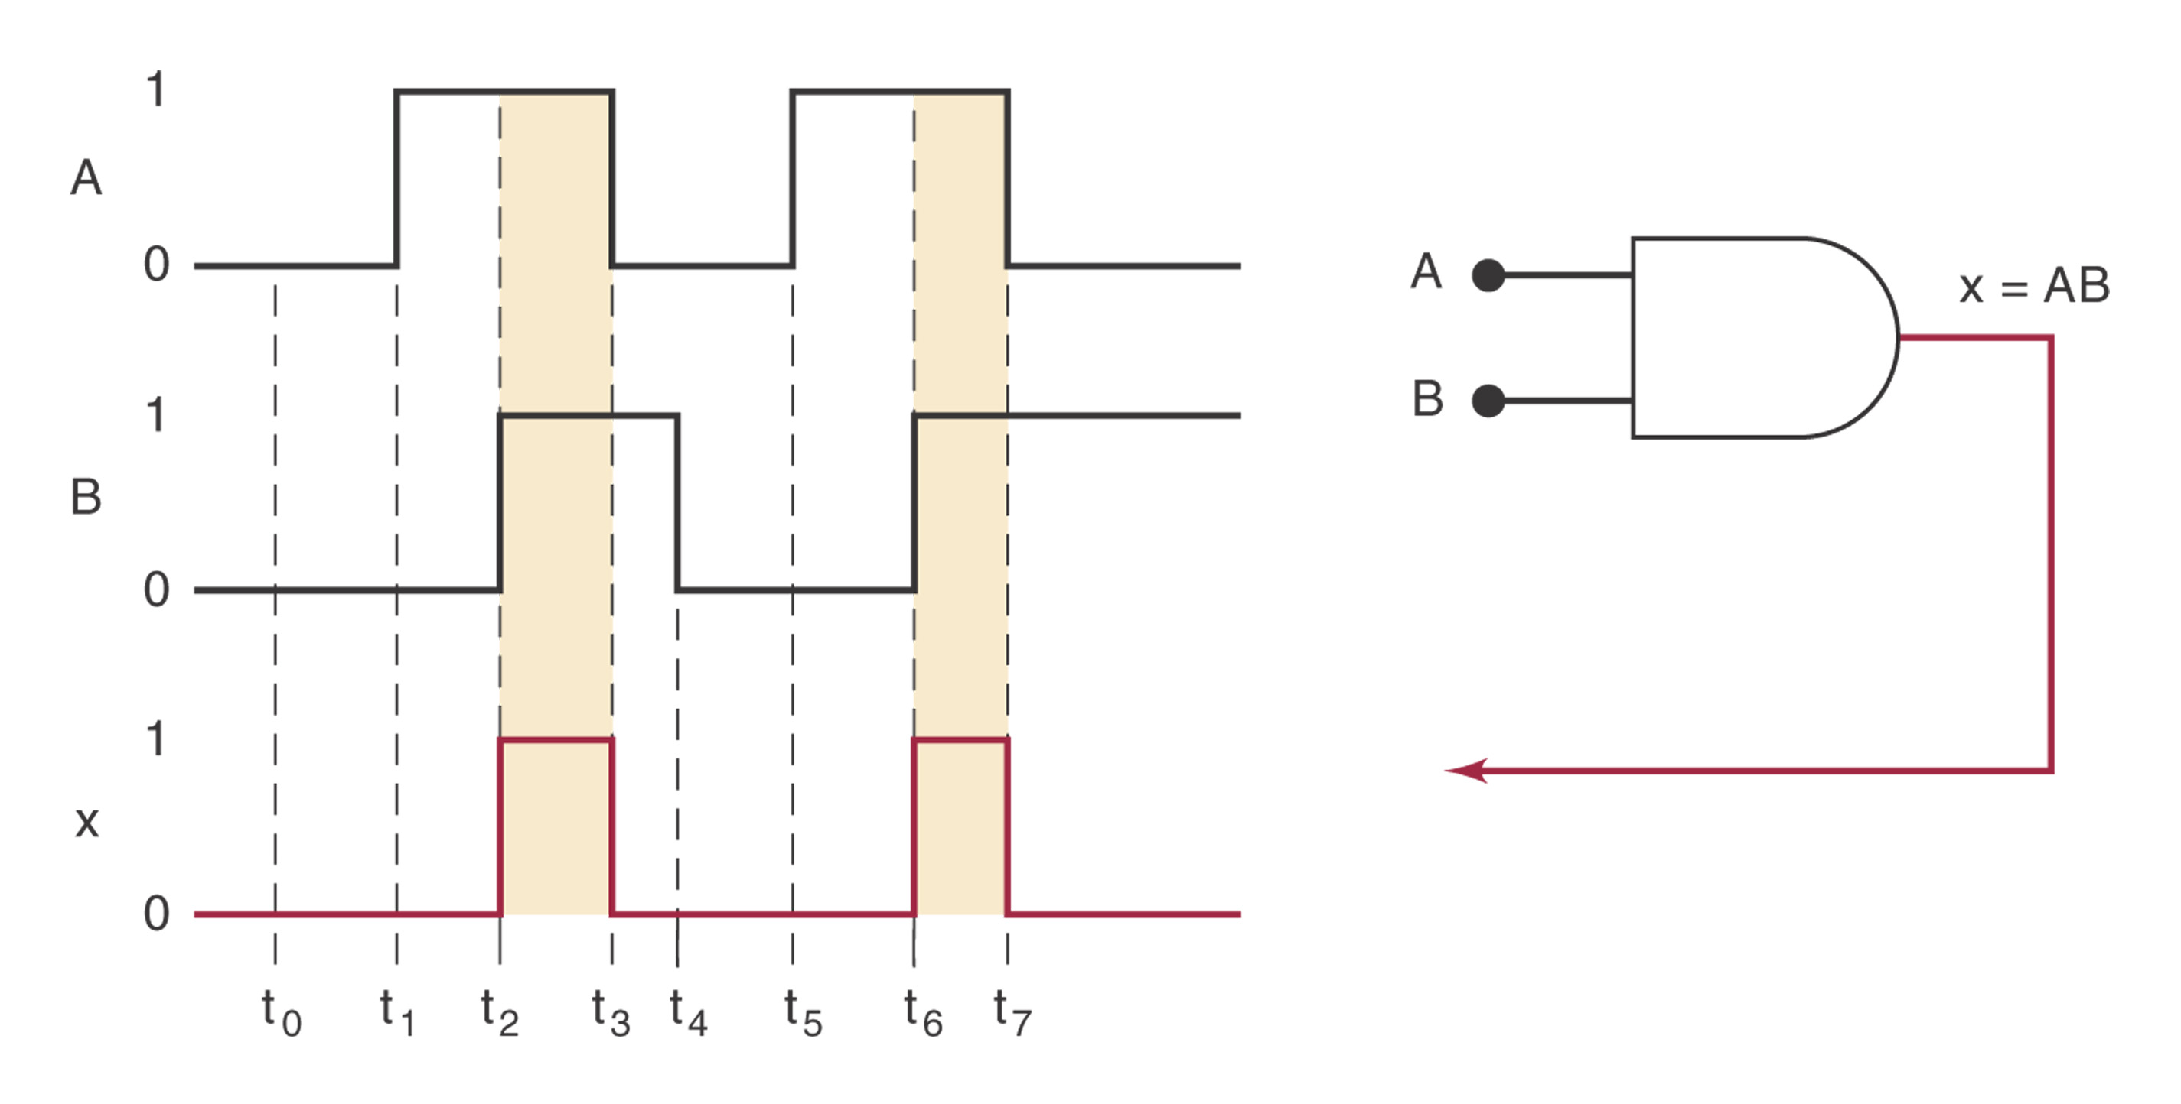
Timing Diagram for AND Gate

Slide 8
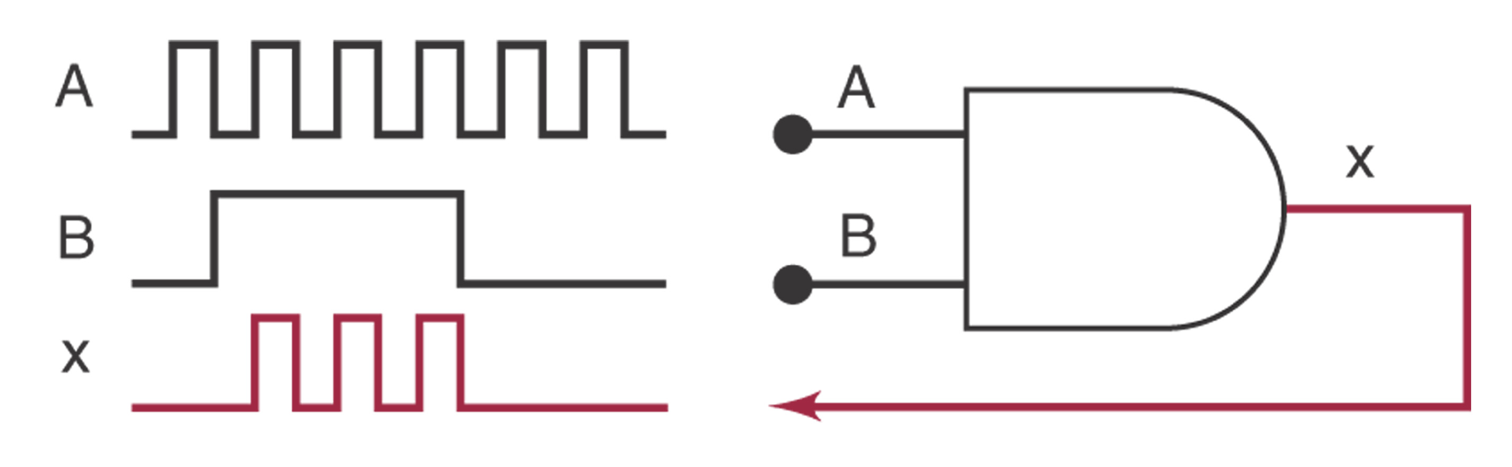

Slide 9
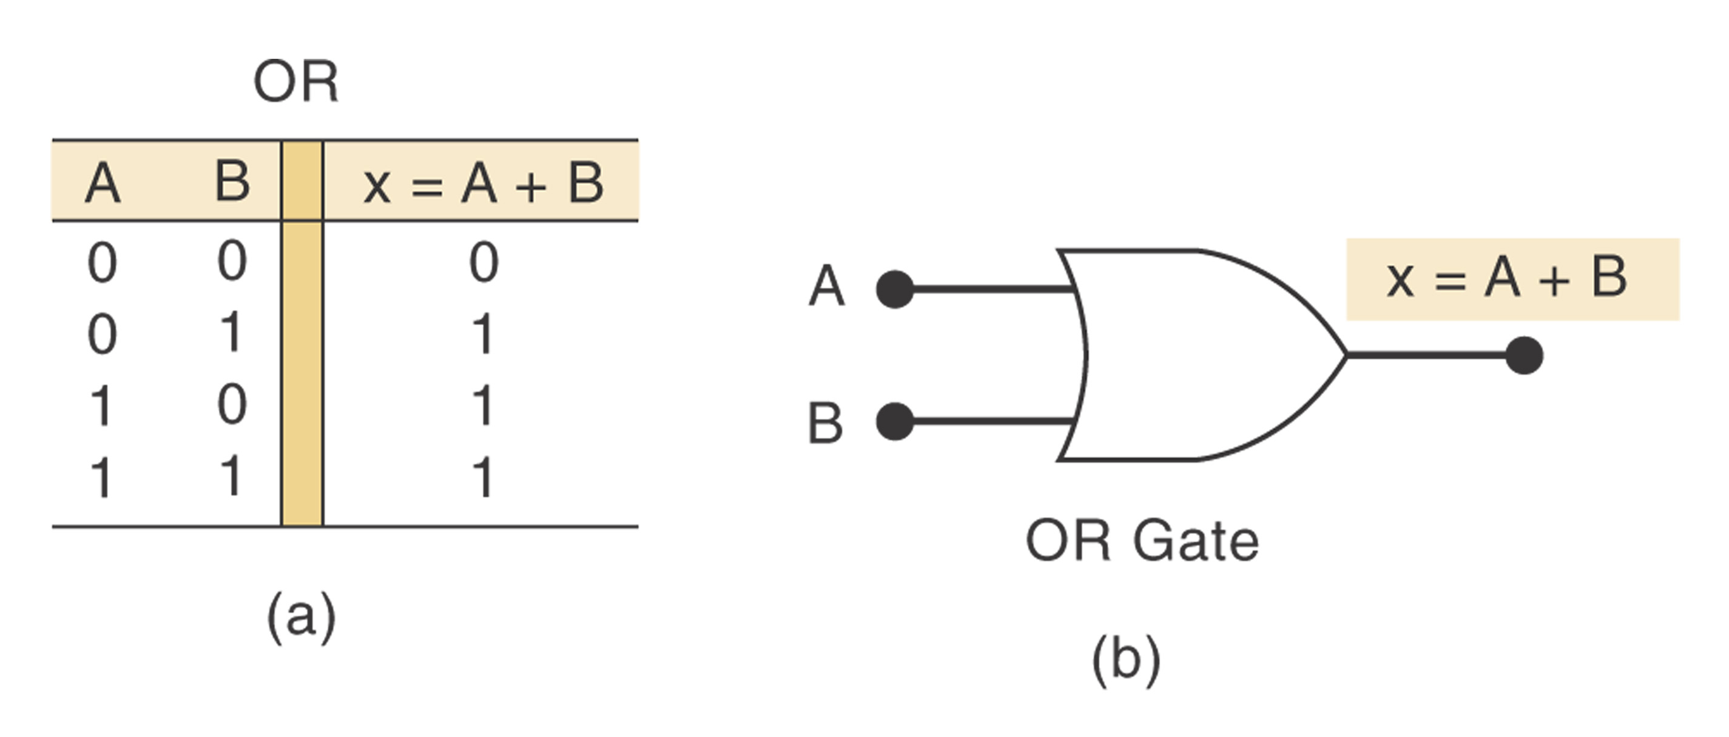
OR Operation
Boolean expression for the OR operation: x =A + B
The above expression is read as “x equals A OR B”

Slide 10
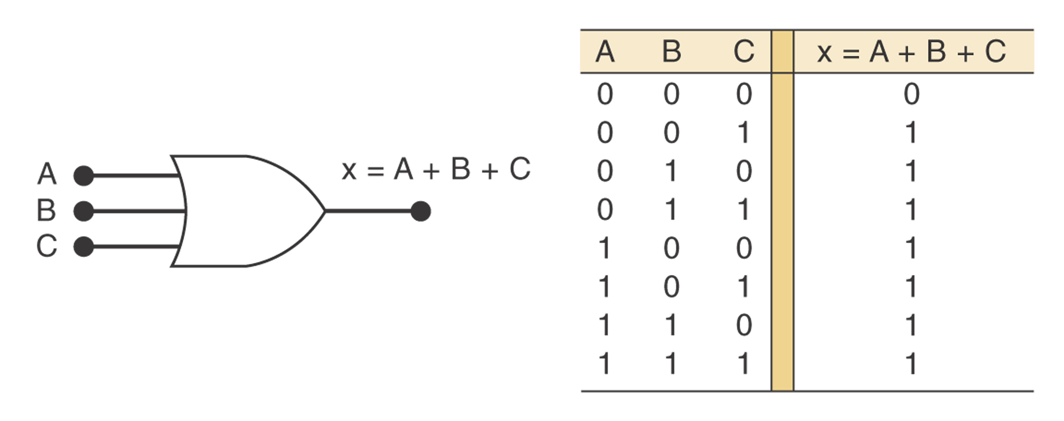
OR Gate
An OR gate is a gate that has two or more inputs and whose output is equal to the OR combination of the inputs.

Slide 11
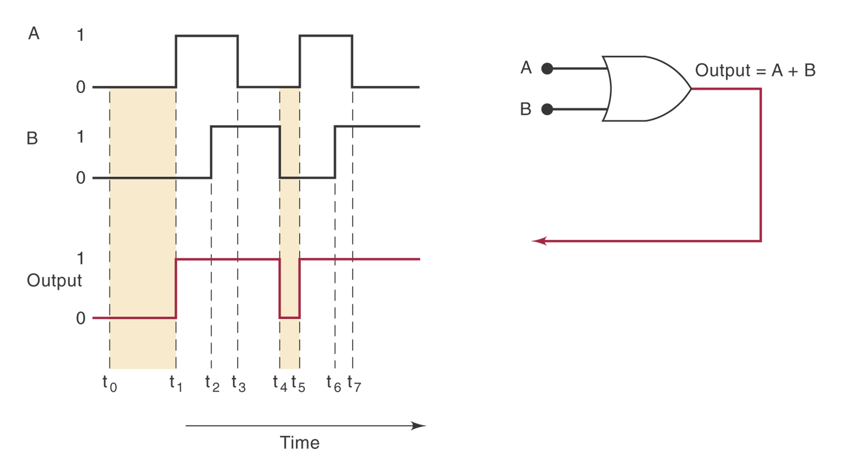
Example
Timing diagram

Slide 12
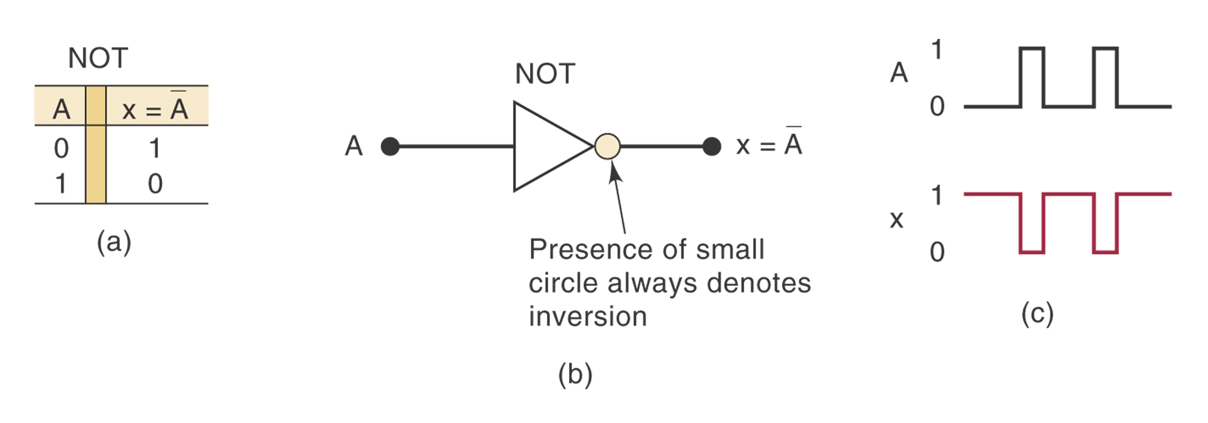
NOT Operation
The NOT operation is an unary operation, taking only one input variable.
Boolean expression for the NOT operation: x = A
read as “x equals the inverse of A”
Also known as inversion or complementation互补.
Can also be expressed as: A’
A
Notes:
一元的

Slide 13
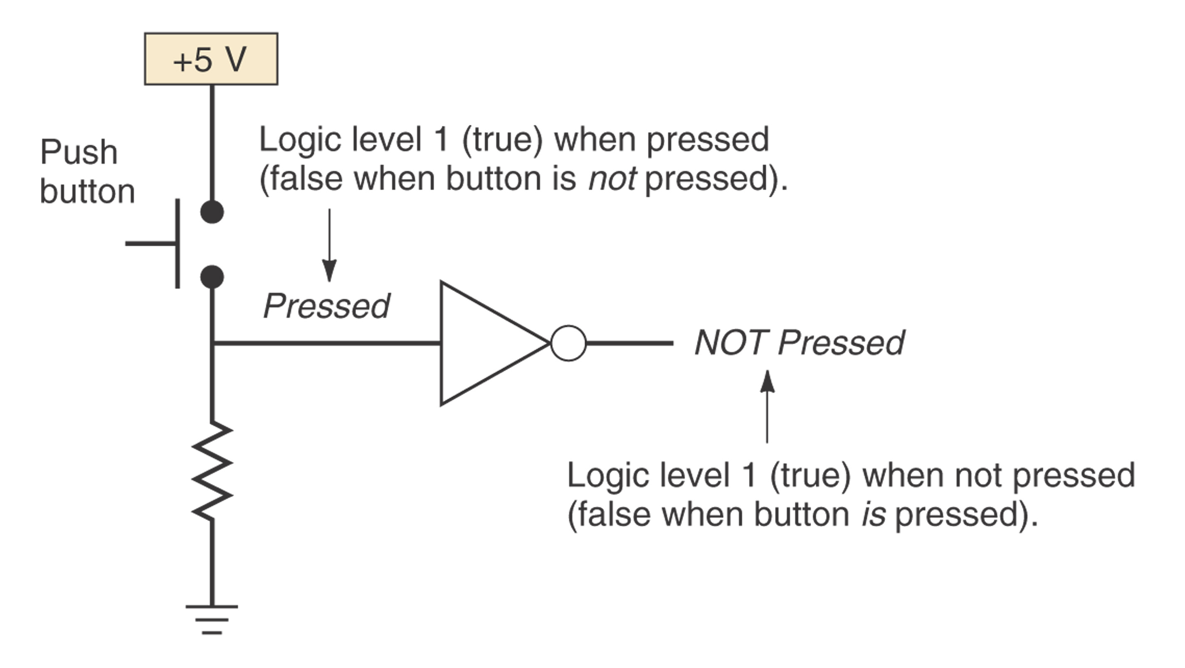
NOT Circuit
Also known as inverter.
Always take a single input
Application:

Slide 14
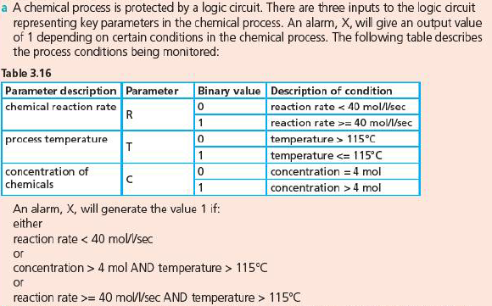
Exercise 1

Slide 15
Describing Logic Circuits Algebraically
Any logic circuits can be built from the three basic building blocks: OR, AND, NOT
Example 1: x = A B + C
Example 2: x = (A+B)C
Example 3: x = (A+B)
Example 4: x = ABC(A+D)
Notes:
代数学上

Slide 16
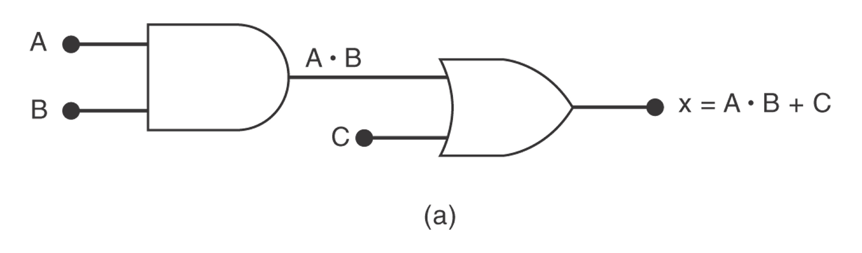
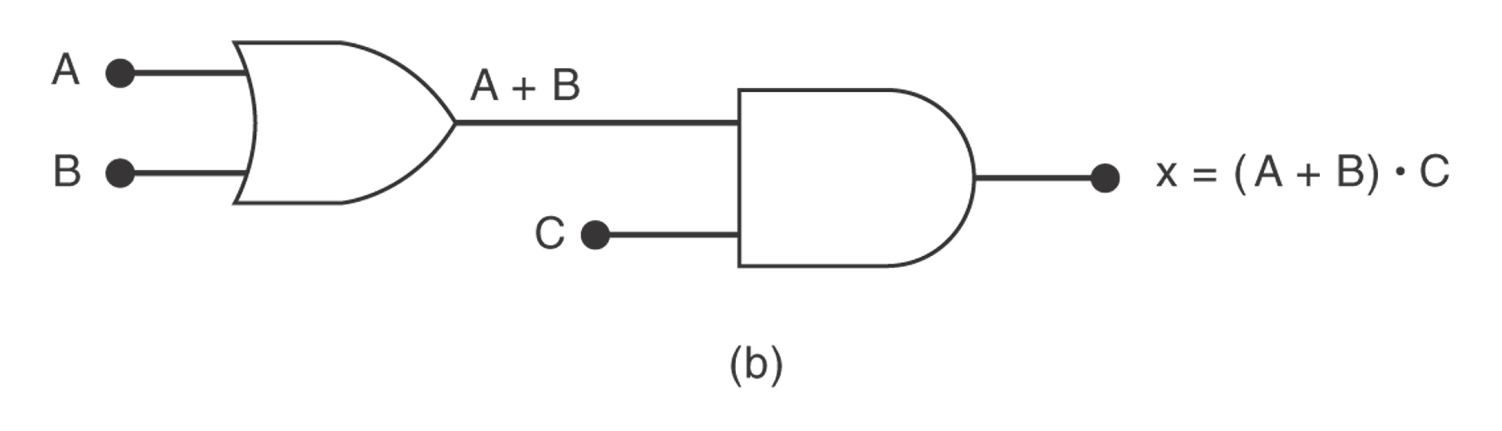
Examples 1,2

Slide 17
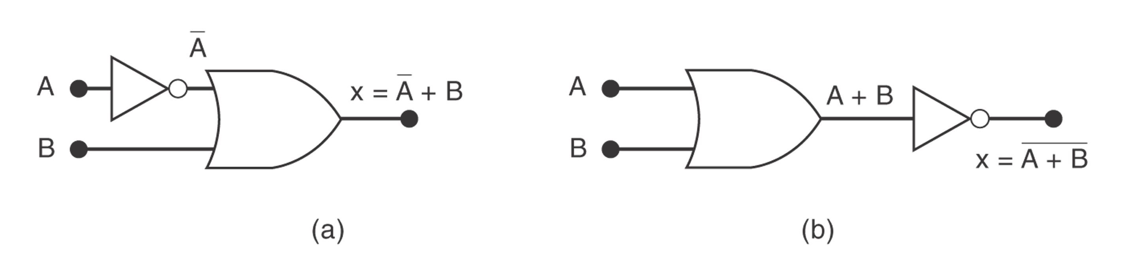
Examples 3

Slide 18
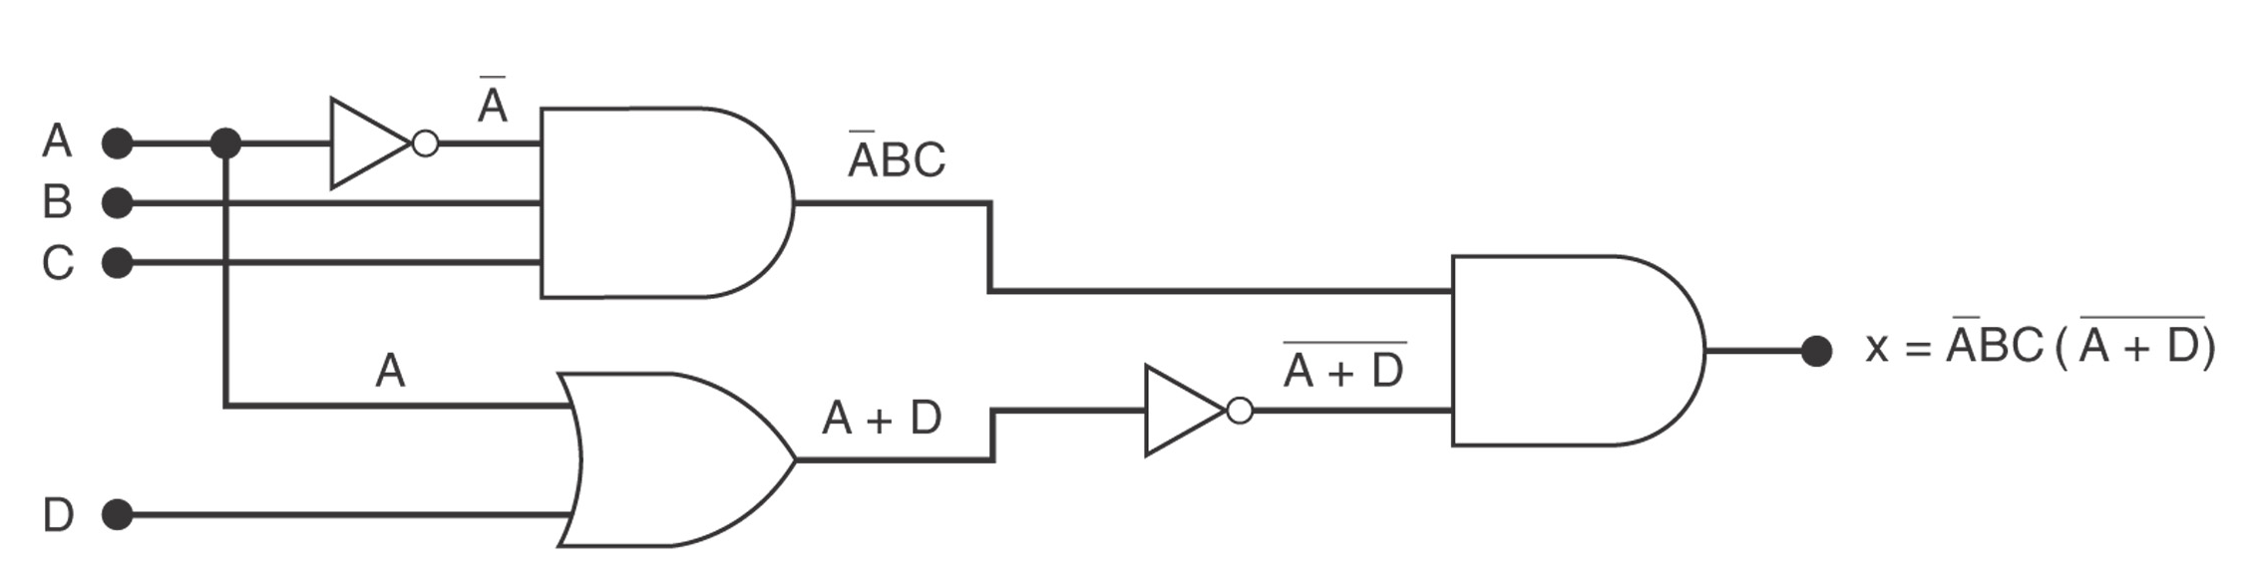
Example 4

Slide 19
Exercise 2
A car alarm is set off 触发 if a window is broken or if it senses something moving inside car, and the car is not being towed拖拽 or the engine is not on.
Where:
A = being towed,
B = window broken,
C = engine on,
D = senses movement
(B+D)·(A’+C’)

Slide 20
Implementing Circuits from Boolean Expressions
y = AC+BC’+A’BC
x = AB+B’C
x=(A+B)(B’+C)

Slide 21
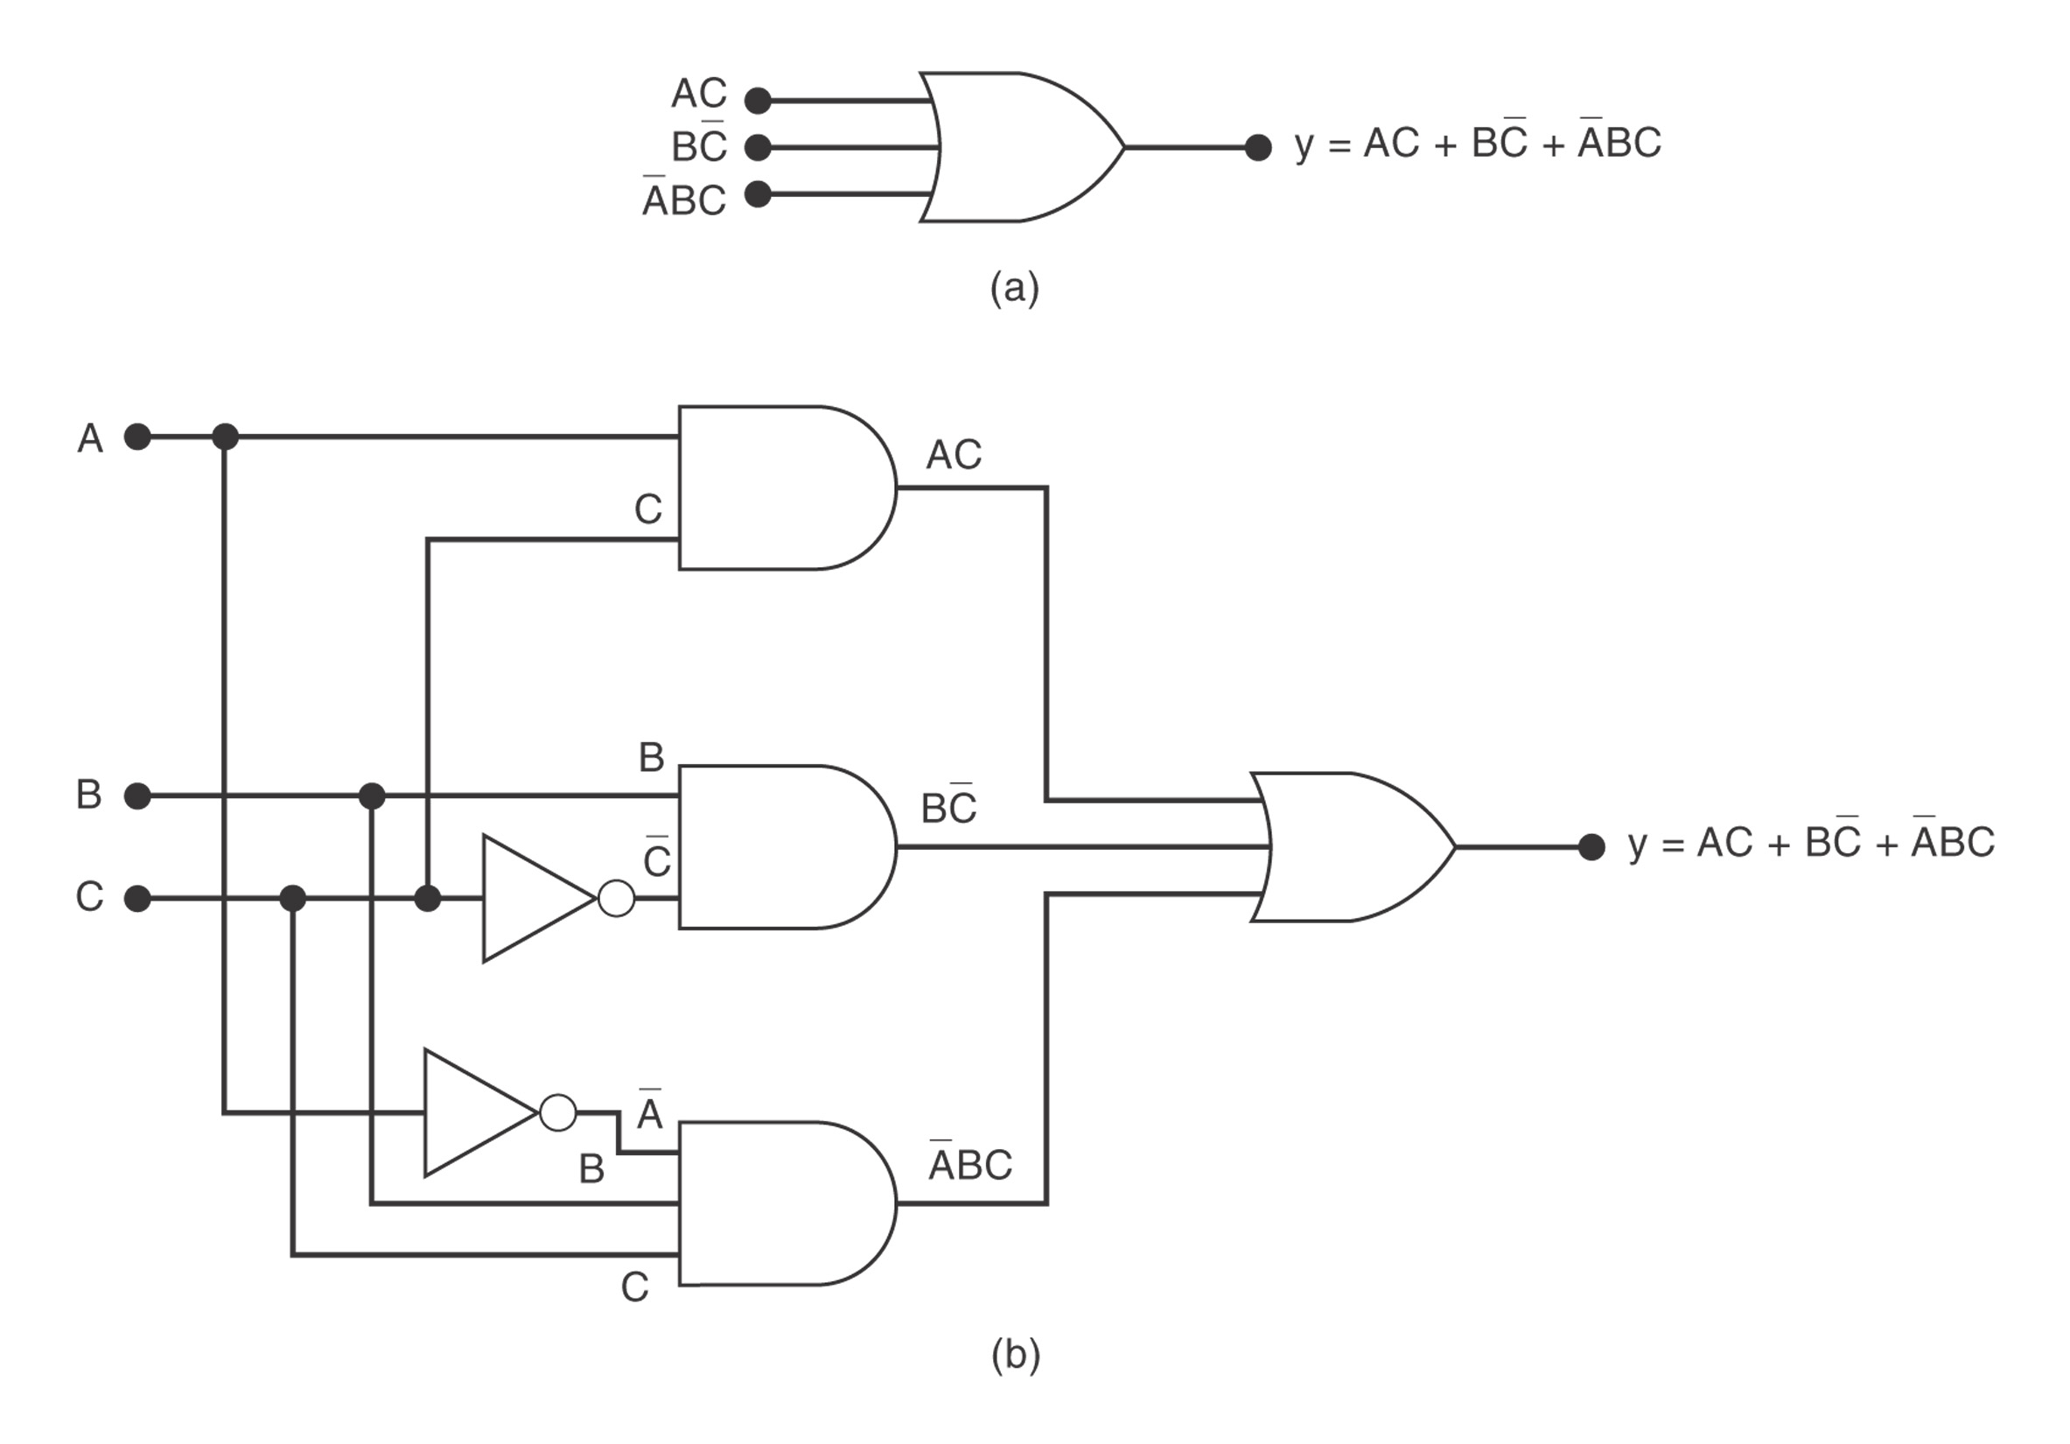

Slide 22
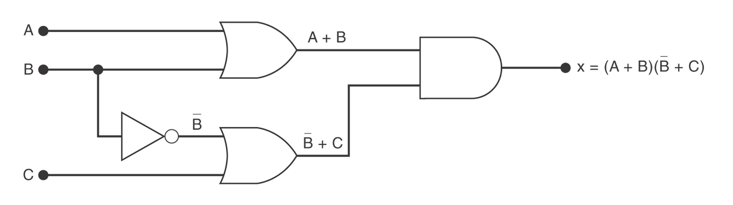
Figure

Slide 23
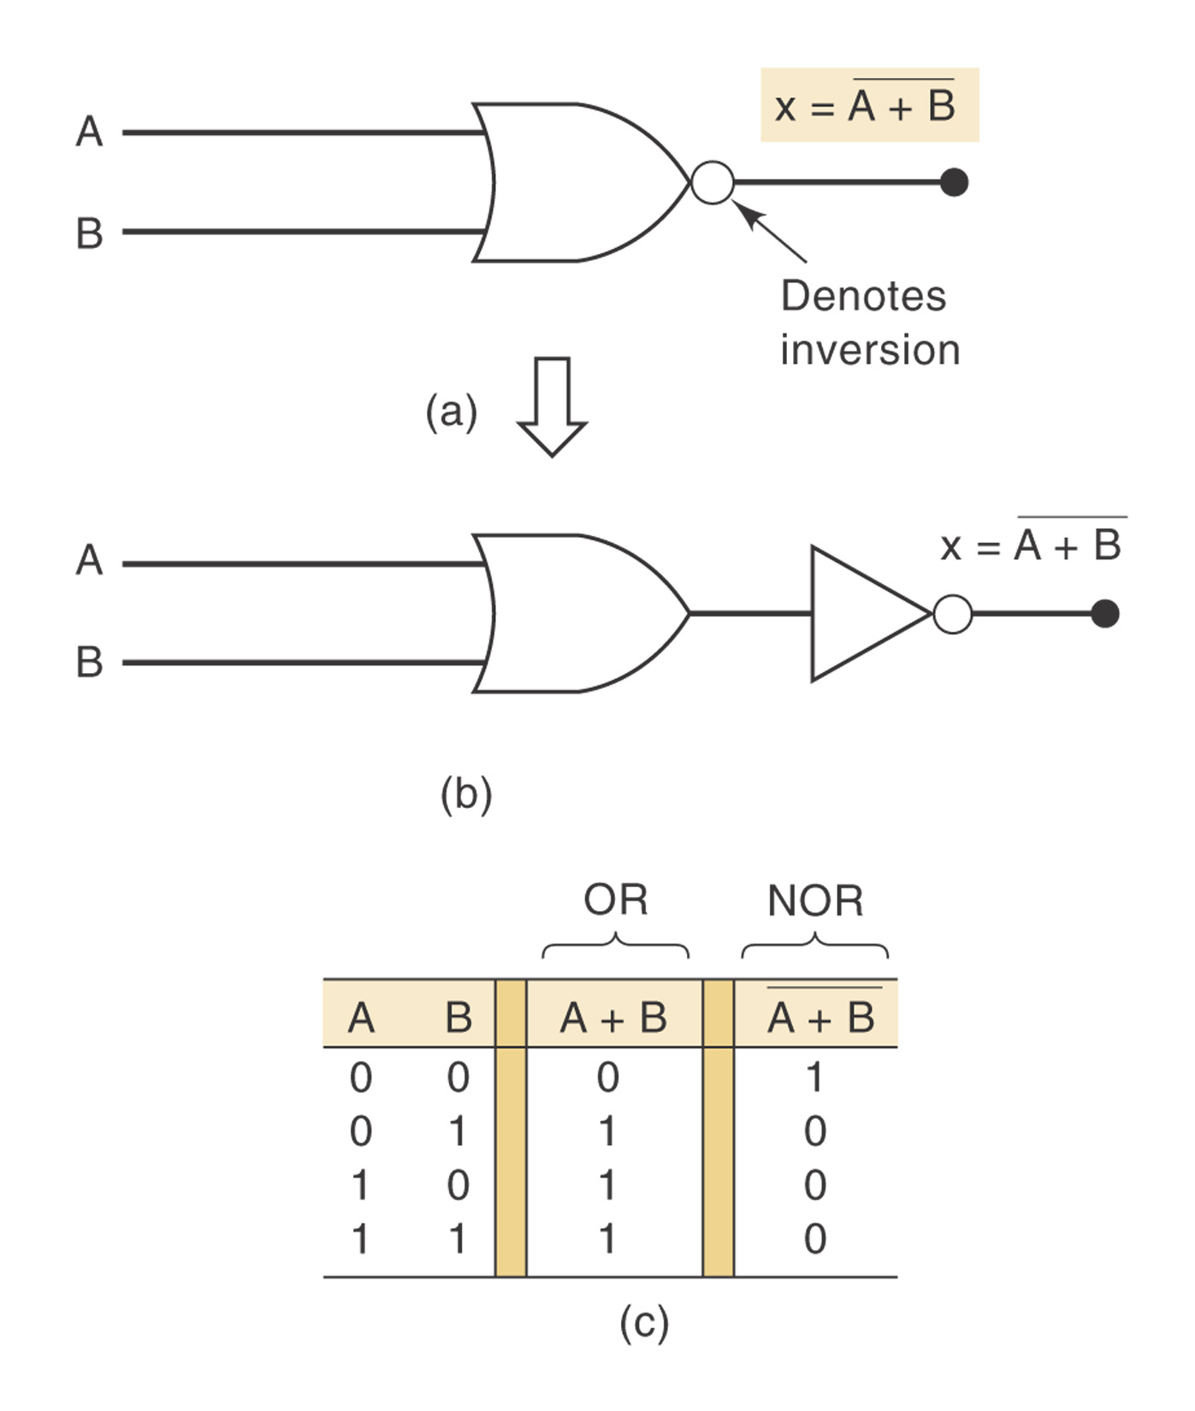
NOR Gate
Boolean expression for the NOR operation: x = A + B

Slide 24
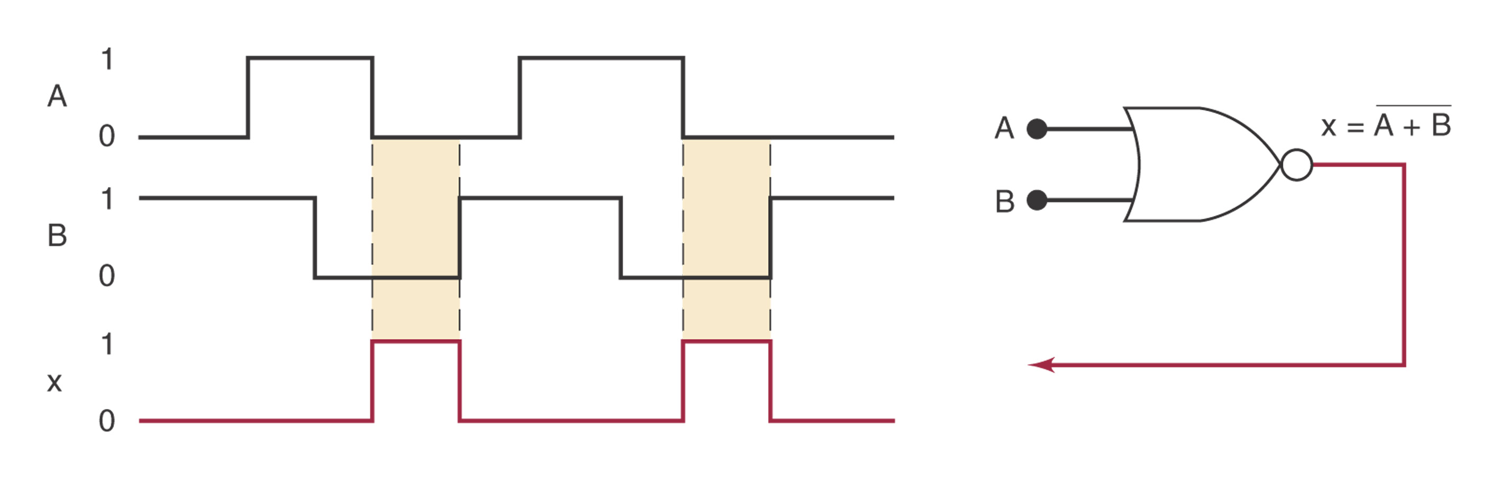
Figure

Slide 25
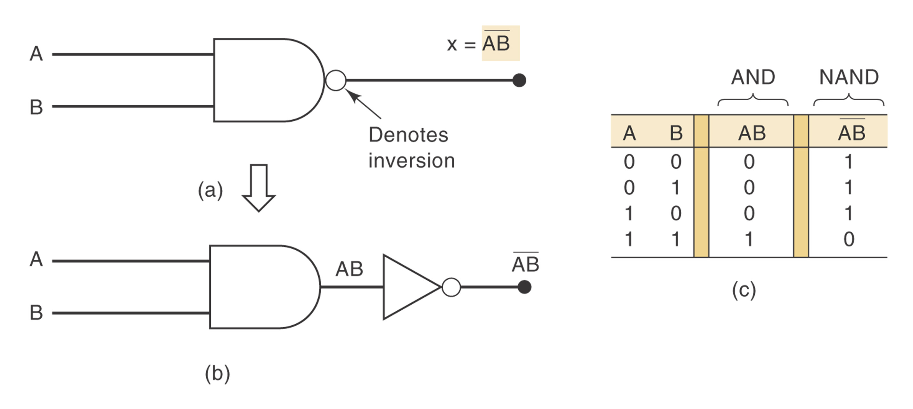
NAND Gate
Boolean expression for the NAND operation: x = A B

Slide 26
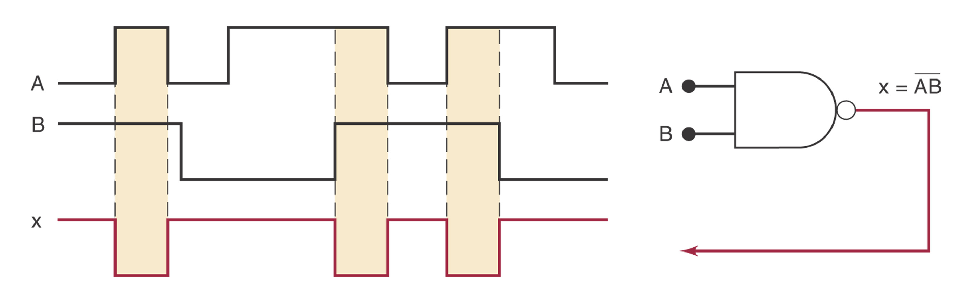
Figure

Slide 27
Boolean Theorems (Multivariable)
x+y = y+x
x*y = y*x
x+(y+z) = (x+y)+z=x+y+z
x(yz)=(xy)z=xyz
x(y+z)=xy+xz
(w+x)(y+z)=wy+xy+wz+xz

Slide 28
DeMorgan’s Theorems 狄摩根定律
(x+y)’=x’y’
Implications and alternative symbol for NOR function
(xy)’=x’+y’
Implications and alternative symbol for NAND function
Extension to N variables

Slide 29
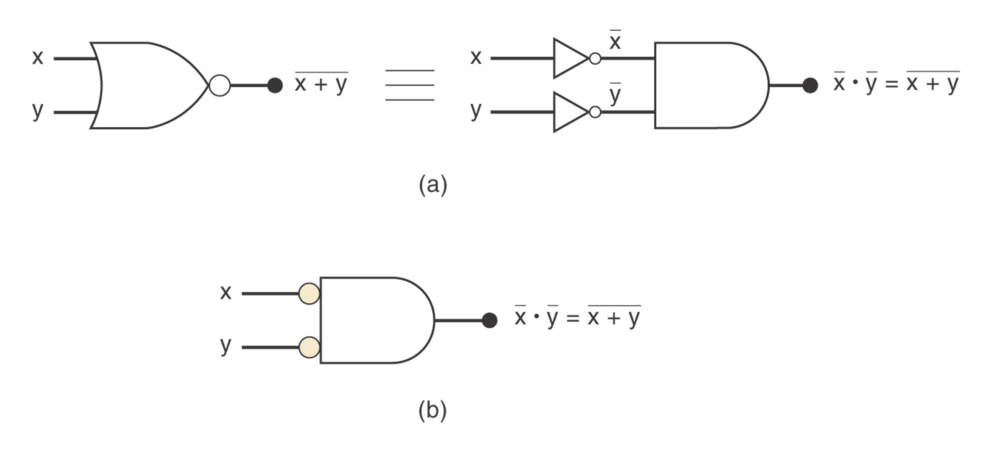
Figure

Slide 30
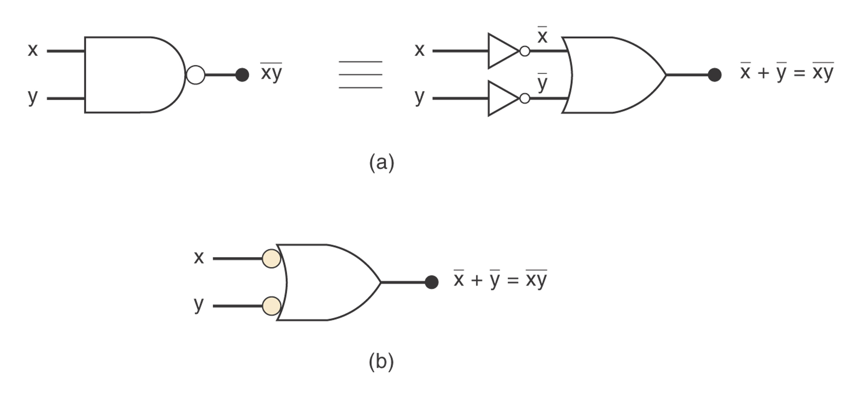
Figure

Slide 31
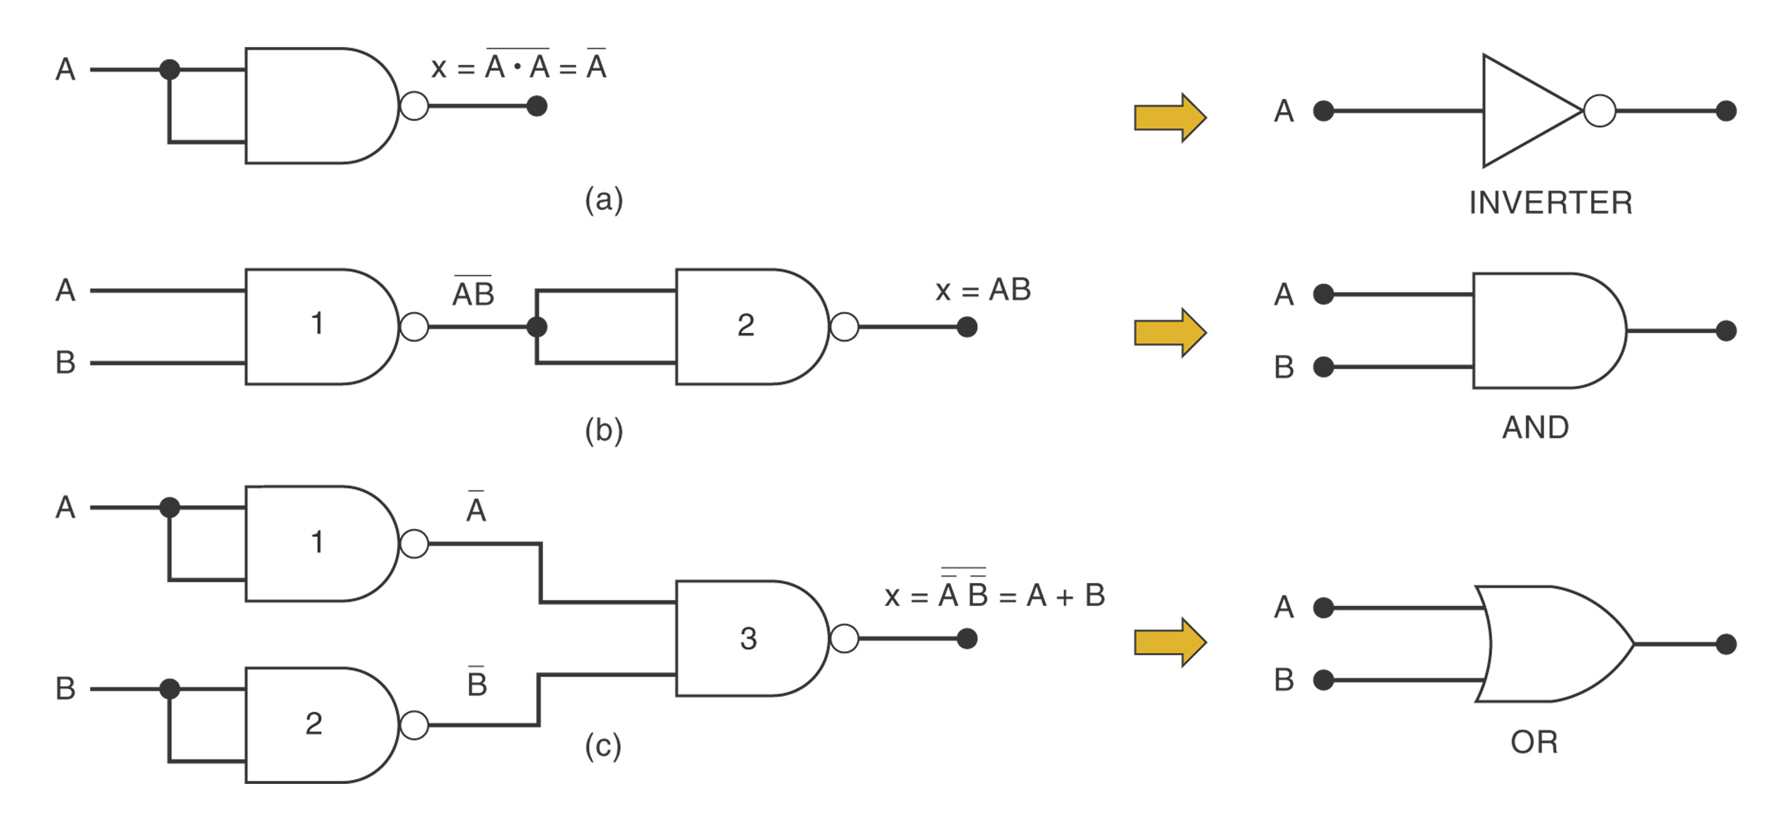
Universality of NAND Gates

Slide 32

XOR Gate
A XOR gate takes two inputs and combines them to form one output
If exactly one input is true then the output will be true. If both the inputs are false or both the inputs are true then the output will be false.

Slide 33
Examples of an XOR gate
(it is raining) XOR (it is not raining) = TRUE
TRUE ⊕ TRUE = FALSE
(9 < 3) ⊕ (2 < 1) = FALSE
(20 = 20) ⊕(8 > 2) = TRUE
A B out
0 0 0
0 1 1
1 0 1
1 1 0

Slide 34
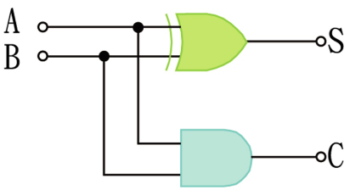
Half adder
A half adder calculates the sum and stores the value of the carry 进位 bit C as well as the result S.

Slide 35
Truth table
a | b | c | s
0 | 0 | 0 | 0
1 | 0 | 0 | 1
0 | 1 | 0 | 1
1 | 1 | 1 | 0

Slide 36
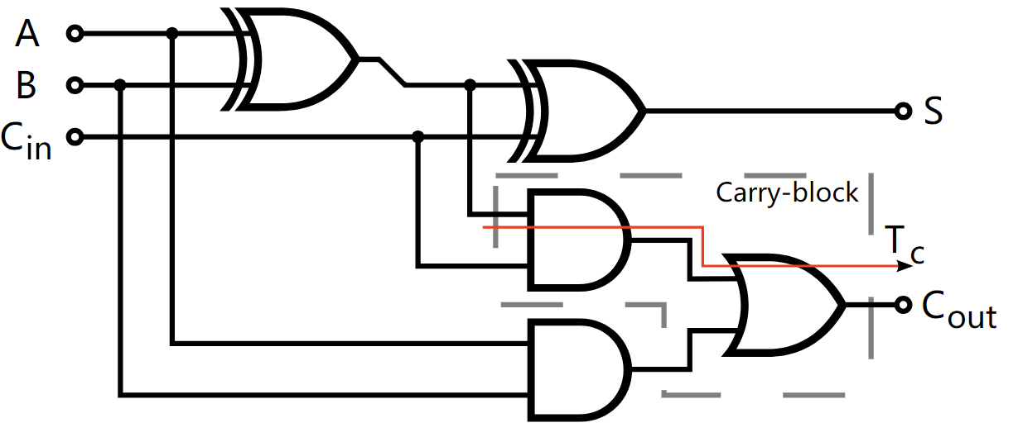
Full adder

Slide 37
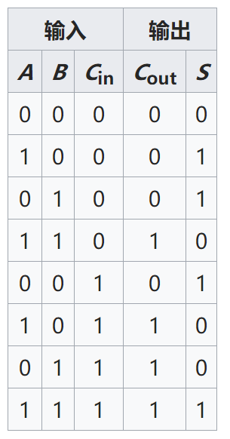
Truth table

